Slide 1
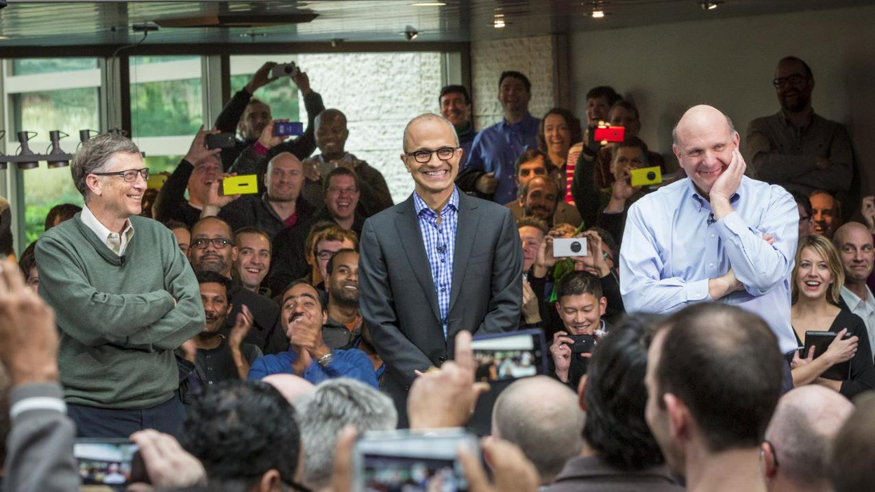
Driving culture awareness and engagement

Slide 2
Managing communications at the CEO level
Employees (100K+)
Public
Executive Staff (200)
Office of the CEO (10)
Senior Leadership (20)
Satya Nadella
Teams
OneNote
Teams
Teams, Email
Yammer
LinkedIn

Slide 3
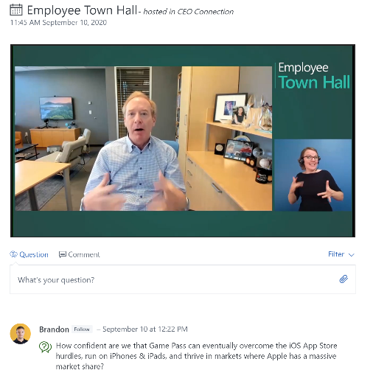
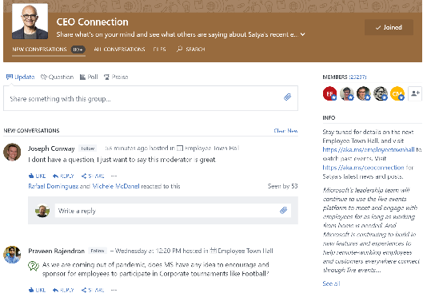
Town Halls Hosted in Yammer
Event Conversation
Event Delivery

Slide 4
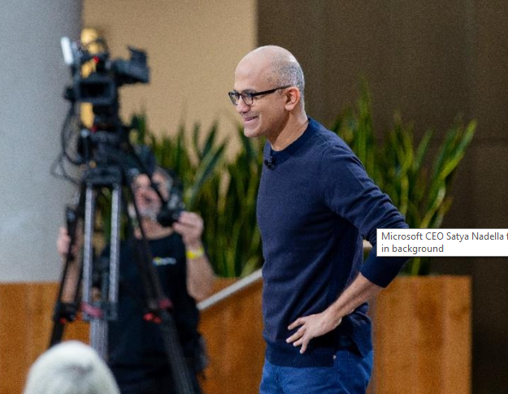
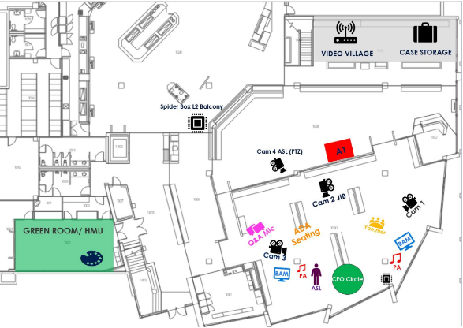
Managing the In-Person Event Production

Slide 5
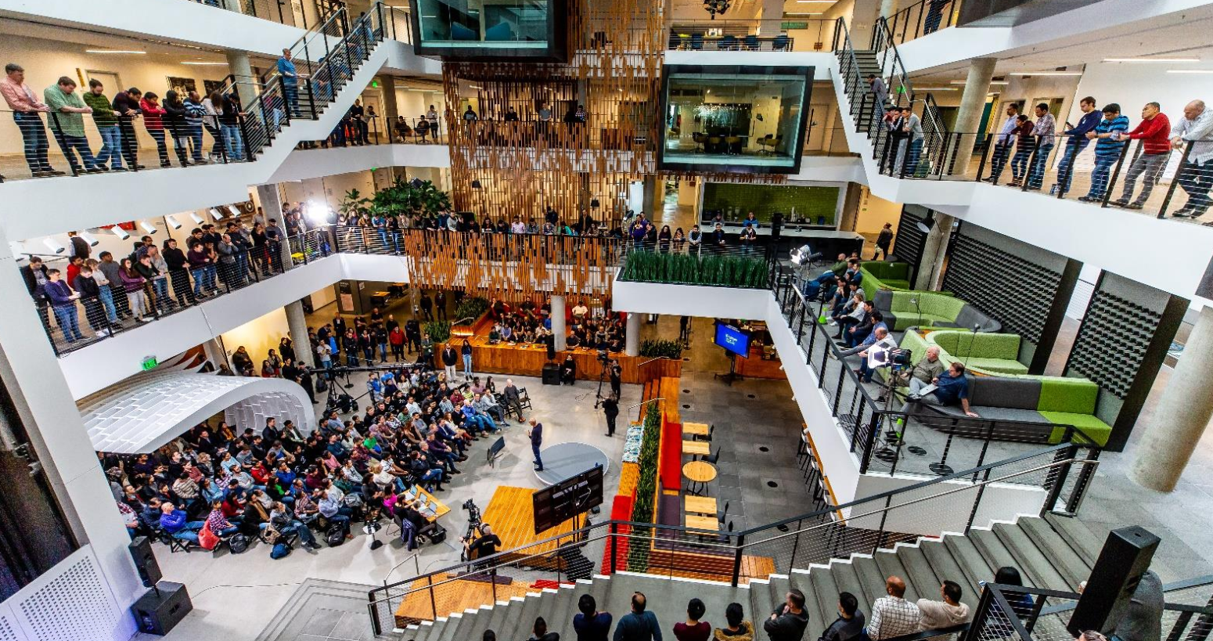

Slide 6
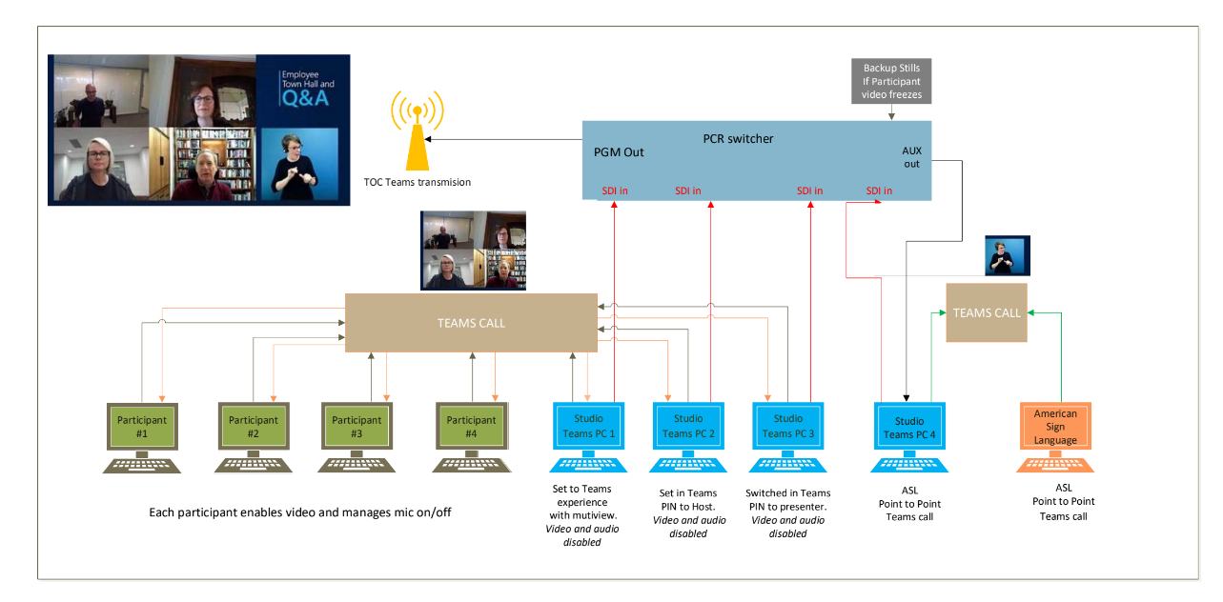

Slide 7
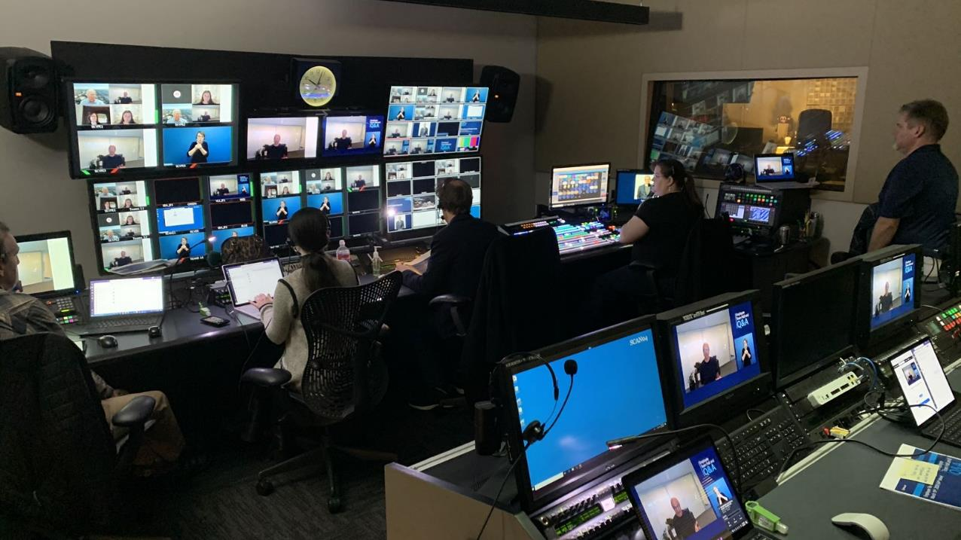

Slide 8
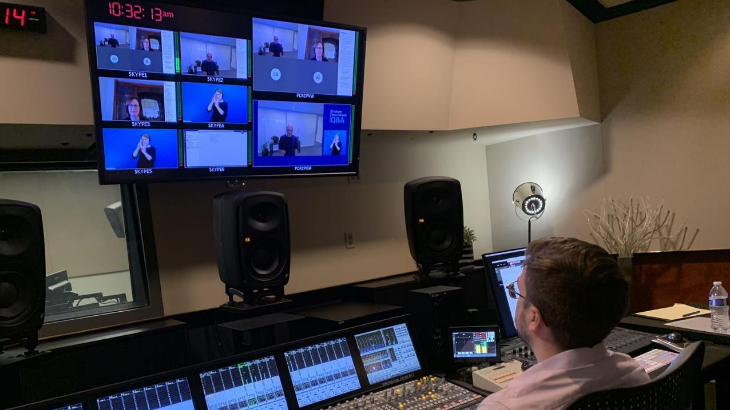

Slide 9
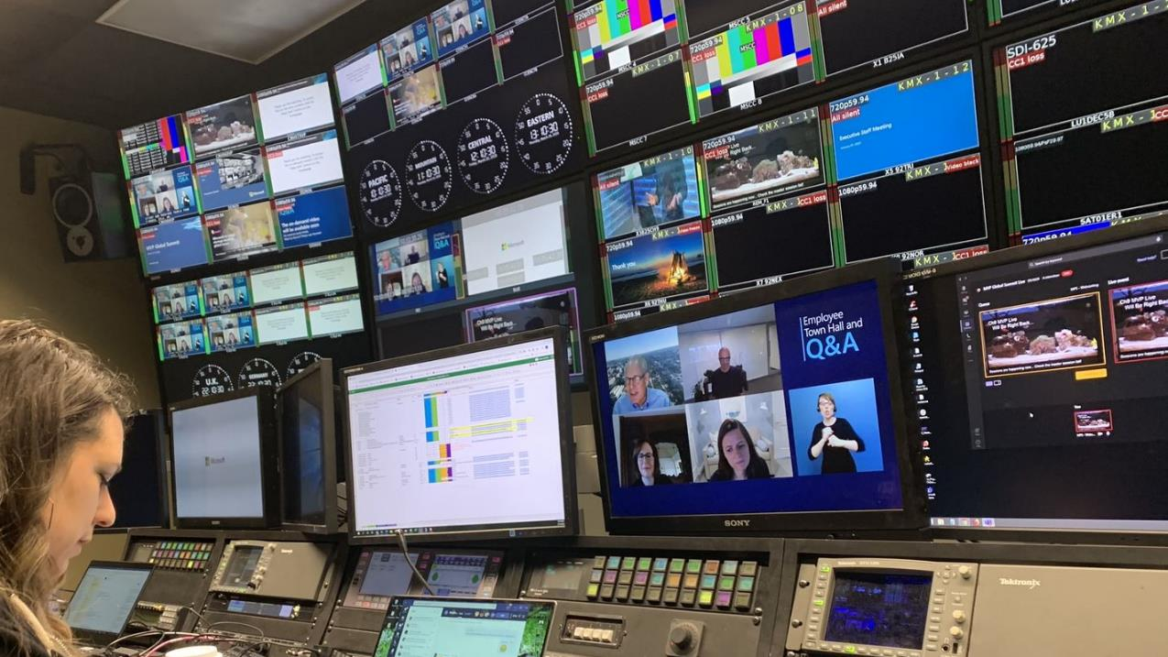

Slide 10
